Slide 1

DEPARTMENT OF COMPUTER SCIENCE AND ENGINEERING
GemAura - ONLINE SHOPPING CART
STUDENT NAME
NARESH KUMAR REDDY T (43110947)

Slide 2
AGENDA
Abstract
Existing system
Proposed system
Advantages
Disadvantages
Hardware requirements
Software requirements
Module description
Sample output(Screenshot)
Conclusion

Slide 3
ABSTRACT
GemAura Jewellery Store is an elegant e-commerce web application designed for a premium online jewellery shopping experience. Built using HTML, Tailwind CSS, and JavaScript with Firebase Firestore as the backend, it enables users to browse and purchase jewellery through a responsive, interactive interface. The platform includes dynamic product displays, category filters, modals, and a real-time shopping cart. With Firebase integration ensuring secure, scalable, and real-time data updates, GemAura combines modern design and smooth performance to deliver a visually appealing and efficient shopping experience across all devices.

Slide 4
EXISTING SYSTEM
Tanishq Online Store
Tanishq’s official e-commerce platform allows users to explore and purchase fine jewellery with secure payment options, virtual try-on, and personalized recommendations. It focuses on brand trust, authenticity, and luxury shopping experience.
CaratLane Jewellery Website
CaratLane offers a user-friendly interface with category-based navigation, price filtering, and 3D product previews. It integrates advanced technologies like AR-based virtual try-on and secure online payments.
Bluestone Jewellery Portal
Bluestone’s online platform provides detailed product listings, real-time availability, and customization features. It emphasizes high-quality visuals and responsive design for mobile and desktop users.
PC Jeweller Online Store
This site features a large catalogue of jewellery with sorting and filtering options, wishlist functionality, and customer reviews. It uses robust backend systems for smooth performance and scalability.

Slide 5
PROPOSED SYSTEMS
The proposed GemAura Jewellery Store Webpage aims to create a modern, responsive, and interactive online platform for purchasing fine jewellery. Unlike traditional e-commerce websites, it focuses on simplicity, performance, and real-time user experience using HTML, Tailwind CSS, JavaScript, and Firebase Firestore.
The system allows users to browse, filter, and view jewellery items such as rings, necklaces, earrings, and bracelets through an intuitive interface. Each product includes detailed descriptions, prices, and interactive modals for a closer look. A real-time shopping cart dynamically updates total costs as users add or remove items.
Data is securely stored and synchronized using Firebase, eliminating the need for complex server setups while ensuring fast, scalable, and reliable performance. The responsive design ensures accessibility across all devices, and Tailwind CSS enhances visual appeal with clean layouts and animations.Overall, the proposed system delivers a premium, efficient, and visually captivating online jewellery shopping experience, blending elegant design with technical innovation.

Slide 6
ADVANTAGES
Supports real-time updates for product listings and user actions.
Minimalistic design enhances brand elegance and improves user focus on products.
Provides a smooth user experience through animations and responsive layouts.
Ensures secure data storage with Firebase authentication and cloud hosting.
Easily scalable, allowing future integration of new categories or features.
Compatible with cross-platform devices (mobile, tablet, desktop).
Simple architecture makes it easy to deploy and manage.
Reduces server maintenance costs due to serverless backend.

Slide 7
DISADVANTAGES
Limited transaction management, unless integrated with a full payment gateway.
Data migration can be complex if moving away from Firebase in the future.
Offline functionality not supported, limiting usability in poor network areas.
Higher learning curve for beginners using Firebase and Tailwind together.
Browser-based performance may vary depending on device speed.
Customization of backend logic is restricted compared to full-stack frameworks.
Security rules must be carefully managed to prevent unauthorized access.
May require third-party integrations for complete e-commerce operations.

Slide 8
HARDWARE REQUIREMENTS
Processor: Intel Core i3 or higher
RAM: Minimum 4 GB (8 GB recommended)
Storage: At least 500 MB free space
Display: 1024×768 resolution or higher
Internet Connection: Required for Firebase integration and testing
Device Compatibility: Desktop, Laptop, Tablet, and Mobile

Slide 9
SOFTWARE REQUIREMENTS
Frontend Technologies: HTML, Tailwind CSS, JavaScript
Backend / Database: Firebase Firestore
Code Editor: Visual Studio Code or Sublime Text
Web Browser: Google Chrome / Firefox / Edge (latest version)
Version Control (optional): Git and GitHub
Testing Tools: Live Server Extension or Firebase Hosting
Operating System: Windows / macOS / Linux

Slide 10
MODULE DESCRIPTION
1. User Interface Module
This module provides a clean and responsive front-end built using HTML, Tailwind CSS, and JavaScript. It ensures smooth navigation, attractive layouts, and easy access to product categories like rings, necklaces, earrings, and bracelets.
2. Product Management Module
Handles product data storage and retrieval using Firebase Firestore. Products can be dynamically displayed, filtered by category, and viewed in detailed modals. Admins can easily update or add new jewellery items.
3. Shopping Cart Module
Allows users to add, remove, and manage jewellery items in real-time. It automatically updates the total price as users modify their selections, offering a seamless and interactive shopping experience.

Slide 11
MODULE DESCRIPTION
4. Firebase Integration Module
Provides the backend connectivity for real-time database operations, authentication, and secure data storage. It ensures smooth synchronization between the client-side application and the database.
5. Category & Filter Module
Enables users to search and filter jewellery items based on categories, price ranges, or product type, improving the browsing efficiency and user experience.
6. Responsive Design & Animation Module
Implements Tailwind CSS utilities and JavaScript animations to make the interface responsive and visually appealing across all devices (desktop, tablet, and mobile).
7. Authentication
Can include user login and registration using Firebase Authentication for personalized shopping, wishlists, and order tracking.

Slide 12
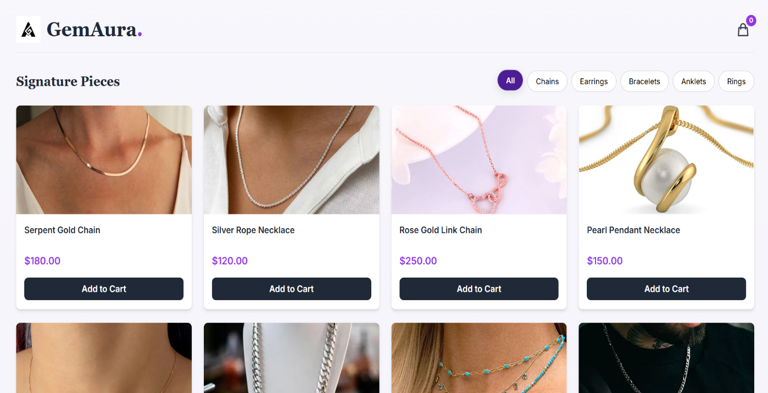
SAMPLE OUTPUT
Fig 1.1 GemAura Interface – Product Display

Slide 13
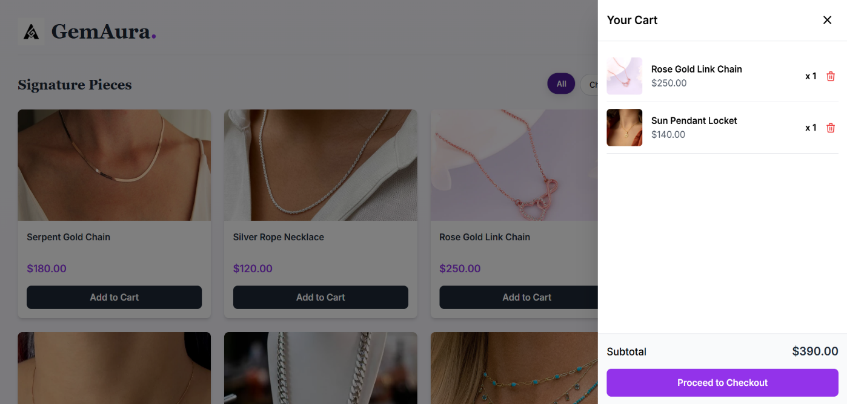
SAMPLE OUTPUT
Fig 1.2 GemAura Cart Overview

Slide 14
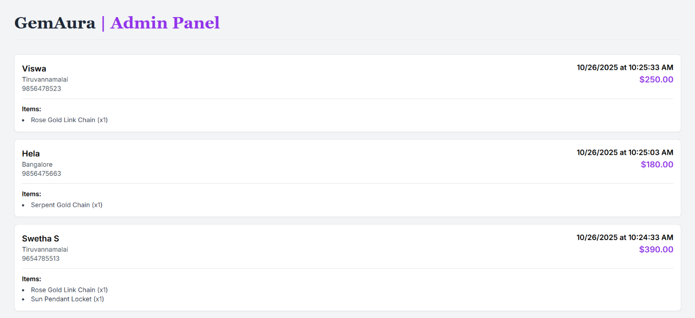
SAMPLE OUTPUT
Fig 1.3 Admin Order Management - GemAura

Slide 15
CONCLUSION
The development of this interactive online jewellery platform showcases the seamless integration of modern web technologies to deliver a user-friendly, responsive, and visually elegant shopping experience. By combining HTML, Tailwind CSS, and JavaScript for the front end with Firebase Firestore as the cloud-based backend, the system achieves both aesthetic appeal and technical efficiency. Features such as product filtering, interactive modals, and a dynamic shopping cart enhance engagement, while Firebase ensures real-time synchronization and secure data storage without traditional server management.
The work follows a structured and user-centered development approach, focusing on design consistency, iterative testing, and scalability. The final outcome demonstrates how creativity and technology can merge to produce a professional, secure, and efficient e-commerce platform. It highlights the potential for future improvements like payment integration, authentication, and order tracking, reinforcing the platform’s adaptability and commitment to modern digital retail standards.

Slide 16
THANK YOU

